Slide 1
Astra Recycling Ltd
An introduction to textile recycling in 2024

Slide 2
Astra Recycling Ltd
The hard facts about fashion.
It takes a lot of water to produce textile, plus land to grow cotton and other fibres. It is estimated that the global textile and clothing industry used 79 billion cubic metres of water in 2021, while the needs of the EU's whole economy amounted to 266 billion cubic metres in 2022
To make a single cotton t-shirt, 2,700 litres of fresh water are required according to estimates, enough to meet one person’s drinking needs for 2.5 years
Textile production is estimated to be responsible for about 20% of global clean water pollution from dyeing and finishing products
According to the European Environment Agency, textile purchases in the EU generate about 654 kg of CO2 emissions per person.
350,000 tonnes, that’s around £140 million worth of used but still wearable clothing goes to landfill in the UK every year.
It is estimated that the fashion industry is responsible for 10% of global carbon emissions – more than international flights and maritime shipping combined.

Slide 3
Astra Recycling Ltd
The Good News:
90% of all textiles can be recycled.
Larger companies are beginning to change their behaviors
The public are becoming more aware of textile waste.
Retailers are under more scrutiny.
WRAP is a climate action NGO working around the globe to tackle the causes of the climate crisis and give the planet a sustainable future. They were established in the UK in 2000; we now work in 40+ countries.
WRAP's ‘Love Your Clothes’ campaign aimed to raise awareness of the value of clothes and encourage people to make the most of the clothes they already have. The campaign was developed as part of the Sustainable Clothing Action Plan..
Textile Recycling companies such as Astra Recycling can responsibly dispose of unwanted textiles.

Slide 4
Astra Recycling Ltd
Who are we?
We are a small textile recycler based in Hampshire.
Dmitry Kukuruza started Astra Recycling in 2013. Having grown up in post-soviet Ukraine, he benefited from used textiles sent from the UK when he was growing up.
Astra started with 2 people, Dmitry running a cash for clothes business from a small warehouse in Portsmouth, selling on to one company in Ukraine and one member of staff sorting through the clothes.
A couple of years later, Dmitry hired his first driver who was sent all over Hampshire collecting clothing from people’s homes and emptying the first textile he banks managed to get into schools.
2018, Charley joined the business,
Fast forward to 2024, we now support 550 sites with our textiles recycling service,

Slide 5
Astra Recycling Ltd
Who are we?
We help churches, community centers, schools, and Scout groups and various other charities to fundraise whilst doing something positive for the environment
We are proud members of the Textile Recycling Association

Slide 6
Astra Recycling Ltd
How it works
It is a free service.
Promotes recycling to the local community.
We provide your site with a textile bank or regular bag collections and pay 20p per kilo for what is collected!
We take Clothing (including branded Uniform), accessories (hats, scarves, gloves, handbags, belts etc), bed linen and soft toys!
We empty the bank every 2 weeks and send records of collections so you can see how much the bank is raising
The textile banks are designed to go outside, they are 2.20m high, 1.15m deep and 1.15m wide, The front opens as a door and bags removed by hand and weighed on scales in the van. Ideally, the van needs to be able to get close the bank when collecting
Payments are processed quarterly via BACS transfer.

Slide 7
Astra Recycling Ltd
What happens to the clothes? Astra Recycling is part of a circular textile economy:
Clothes donated to Astra Recycling
Purchased at retail stores
Shipped to Eastern Europe and sorted and graded
Good quality clothing is sold to second hand retailers, and donated to charity shops to sell at discounted rates to general public
Clothes imported to UK
Rags are broken down onto cleaning wipes and insulation materials/ Cotton rich rags broken down to create new clothes

Slide 8
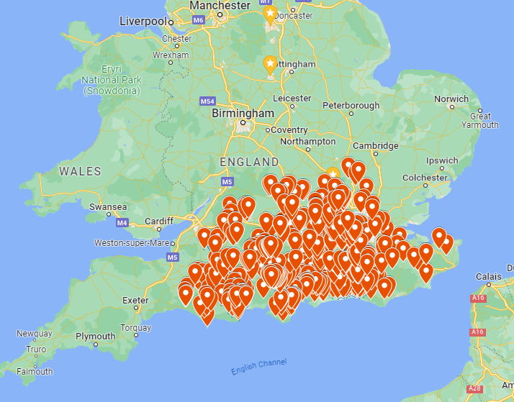
Astra Recycling Ltd
Where Do We Cover?
Astra Recycling offer textile banks, textile recycling and fundraising in;
Hampshire
Isle of Wight
Dorset
Wiltshire
Berkshire
East/West Sussex
Surrey
Oxfordshire
Buckinghamshire
Hertfordshire
Kent
Gloucestershire
Somerset
Essex

Slide 9
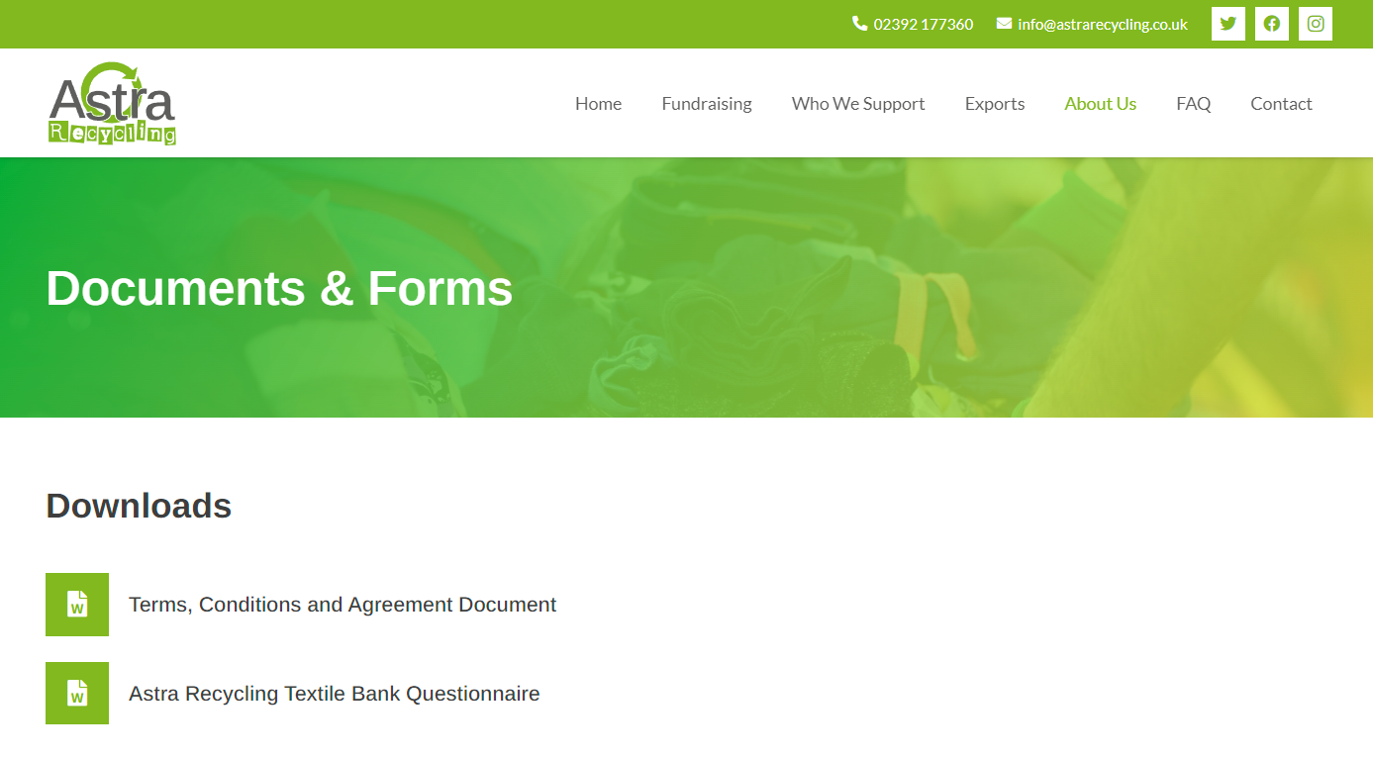
Astra Recycling Ltd
How do you Get Invloved?
If you go to www.astrarecycling.co.uk you can download 2 forms to complete and then I can arrange delivery within 2 weeks
Or, if you prefer I can email the forms to you 😊

Slide 10
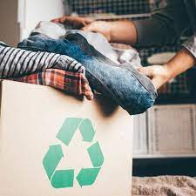
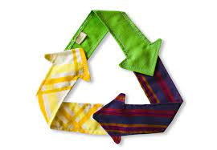
Astra Recycling Ltd
Thank you for your interest I am here to answer any questions you may have. Please either contact me on 02392177360 or at charley.francis@astrarecycling.co.uk

